Slide 1
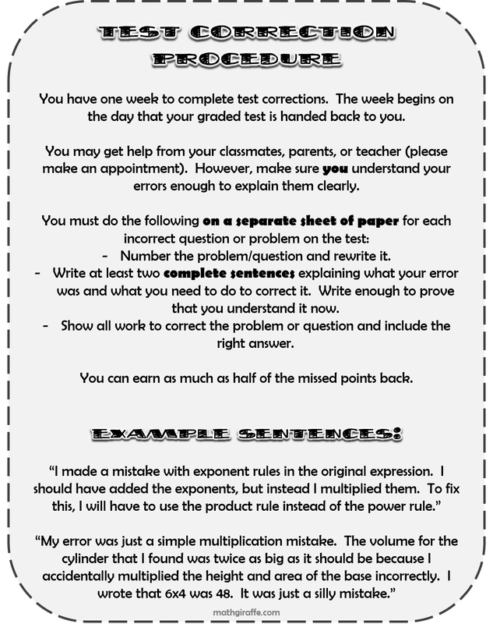
Welcome to Math Class!
I look forward to working with all of you this year as we explore math concepts in depth and have some fun along the way. Our classroom will be hands-on, collaborative and engaging as we work together using math and solving real- world problems. I look forward to getting to know each of you and am excited about the new school year.
Mrs. Sisson
Grading Policy: Algebra 1A
Students will be graded on a percentage system. The major categories are as follows:
Homework/Assignments: 30% Tests/Quizzes: 50% points Participation: 20% *Late work will be ½ credit*
Geometry/Algebra 1A
Mrs. Patty Sisson
sissonp@manateeschools.net
(941) 727-6100 ext. 2227
Grading Policy: Geometry
Students will be graded on a percentage system. The major categories are as follows:
Homework: 30%
Tests: 50%
Quizzes: 20%
*Late work will be worth ½ credit.
Afternoon help sessions I offer extra help in the afternoons on Tuesdays, Wednesdays, and Fridays from 2:30pm-3:15pm. Students can attend any or all sessions. *Bring any work and books needed
*If other students are here I may not get to you right away.
Class Website www.pattysissonmath.weebly.com
Or visit Schoology through Webnet
.
Required Classroom Supplies (Due Monday, August 20th, 2018)
½ Inch Binder
Pencils (mechanical preferred), pens, erasers, highlighter
Pencil sharpener with catch basin
Expo markers (A few for personal use)
Please choose any of the items below to provide for the math classroom: Expo-brand markers, Tissues, Clorox wipes, Sheet protectors, Paper towels, Lysol spray, pencils, loose leaf paper, small wrapped candies, post it notes, graph paper, copy paper, binders.
*These items are for extra credit*
Notes:
http://www.teacherspayteachers.com/Store/The-Enlightened-Elephant

